Slide 1
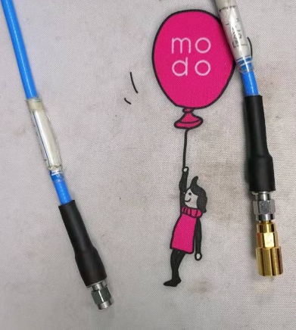
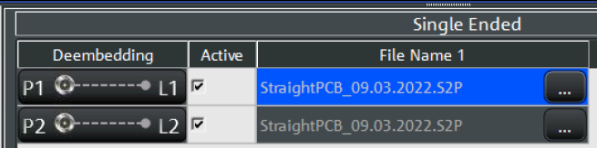
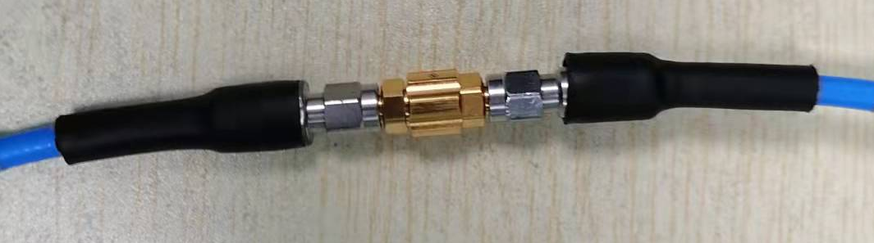
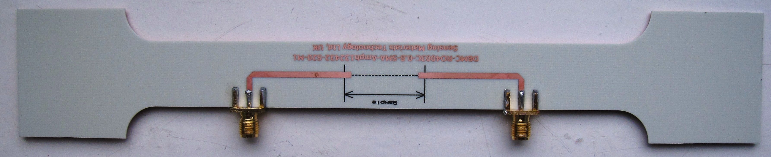
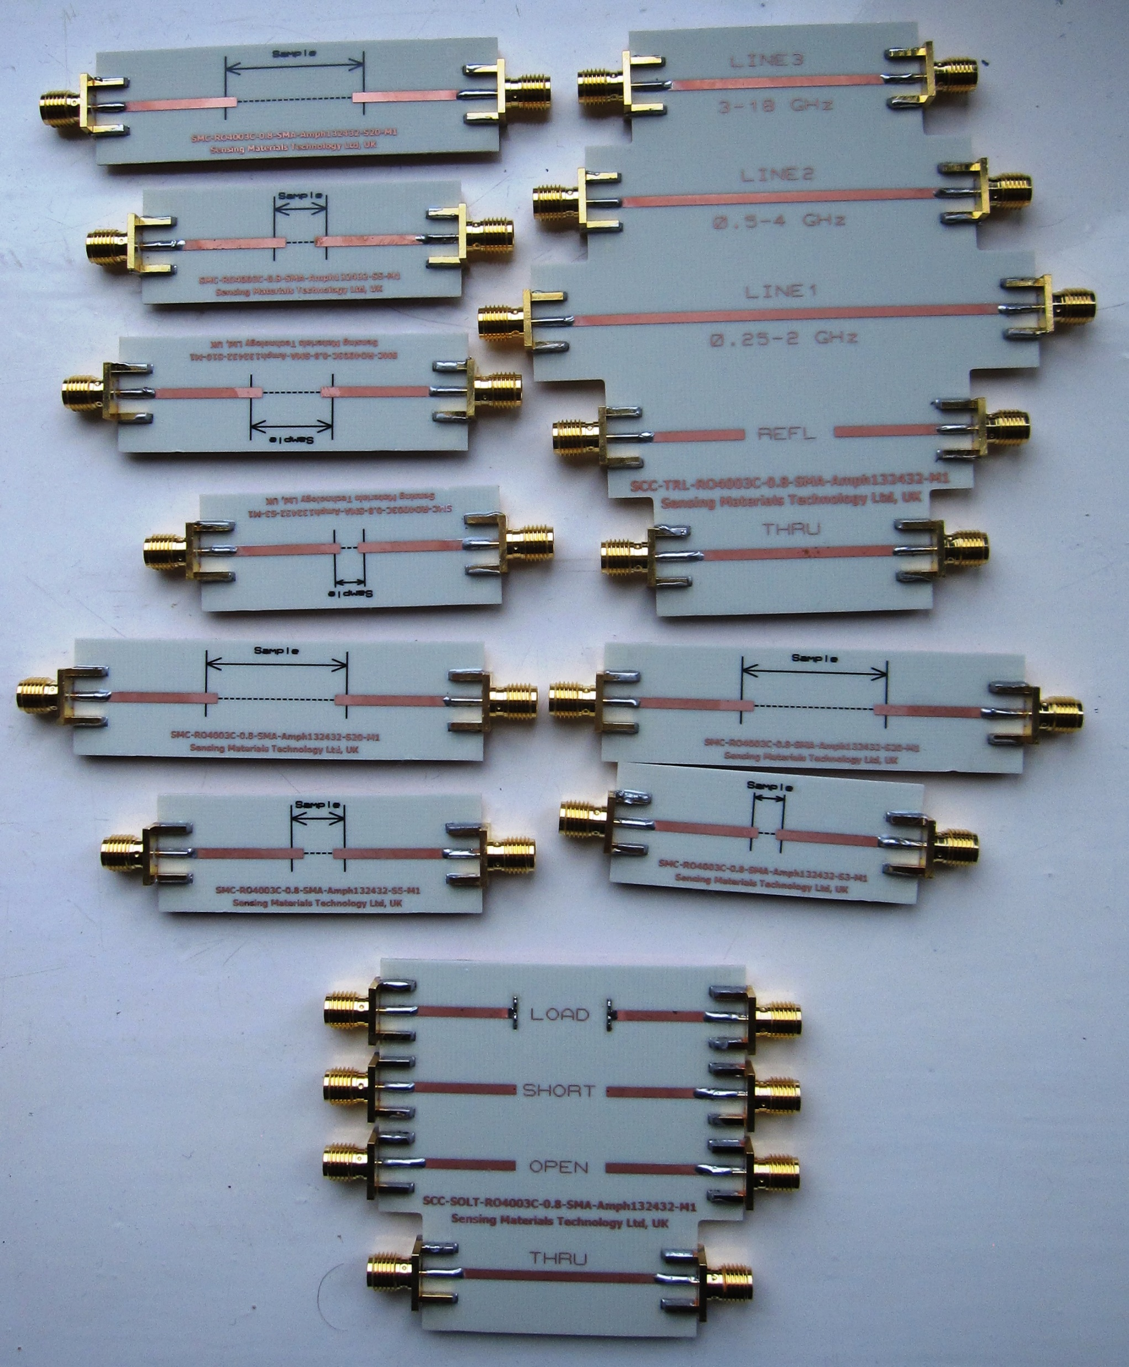
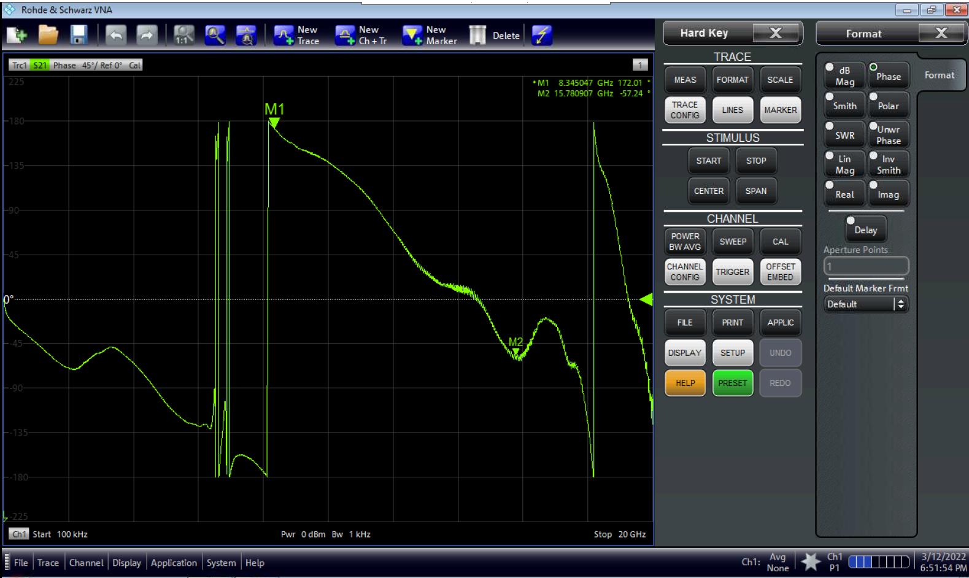
Dogbone PCB cell
SOLT/TOSM – standard 2-port VNA calibration procedure with the coaxial terminations (R&S mechanical cal kit)
Cable
Port I
Microstrip
PCB cell
Stage II:
Deembedding
Straight PCB cell
VNA
Stage I:
SOLT/TOSM
Stage III:
Delay Time Compensation
Sample
Stage II:
Deembedding
Cable
Port II
Microstrip
PCB cell

Slide 2
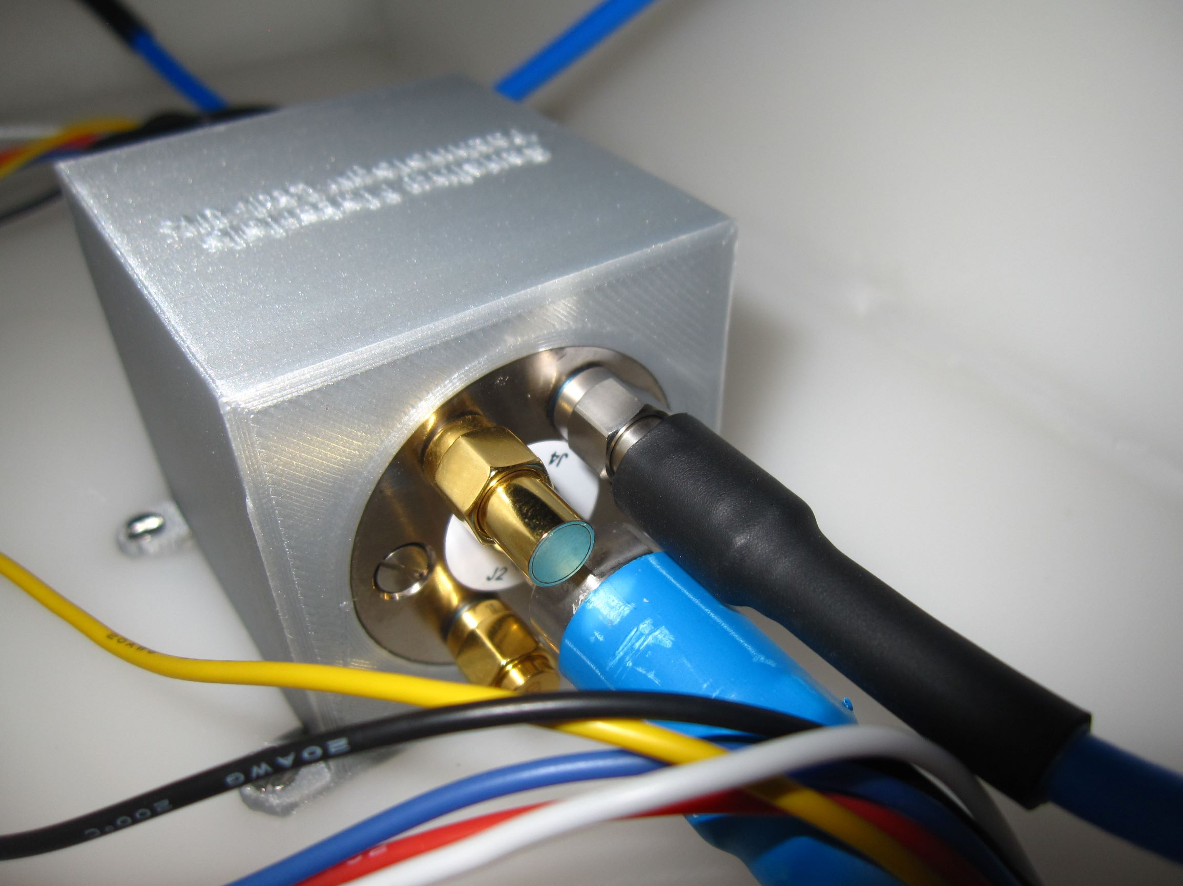
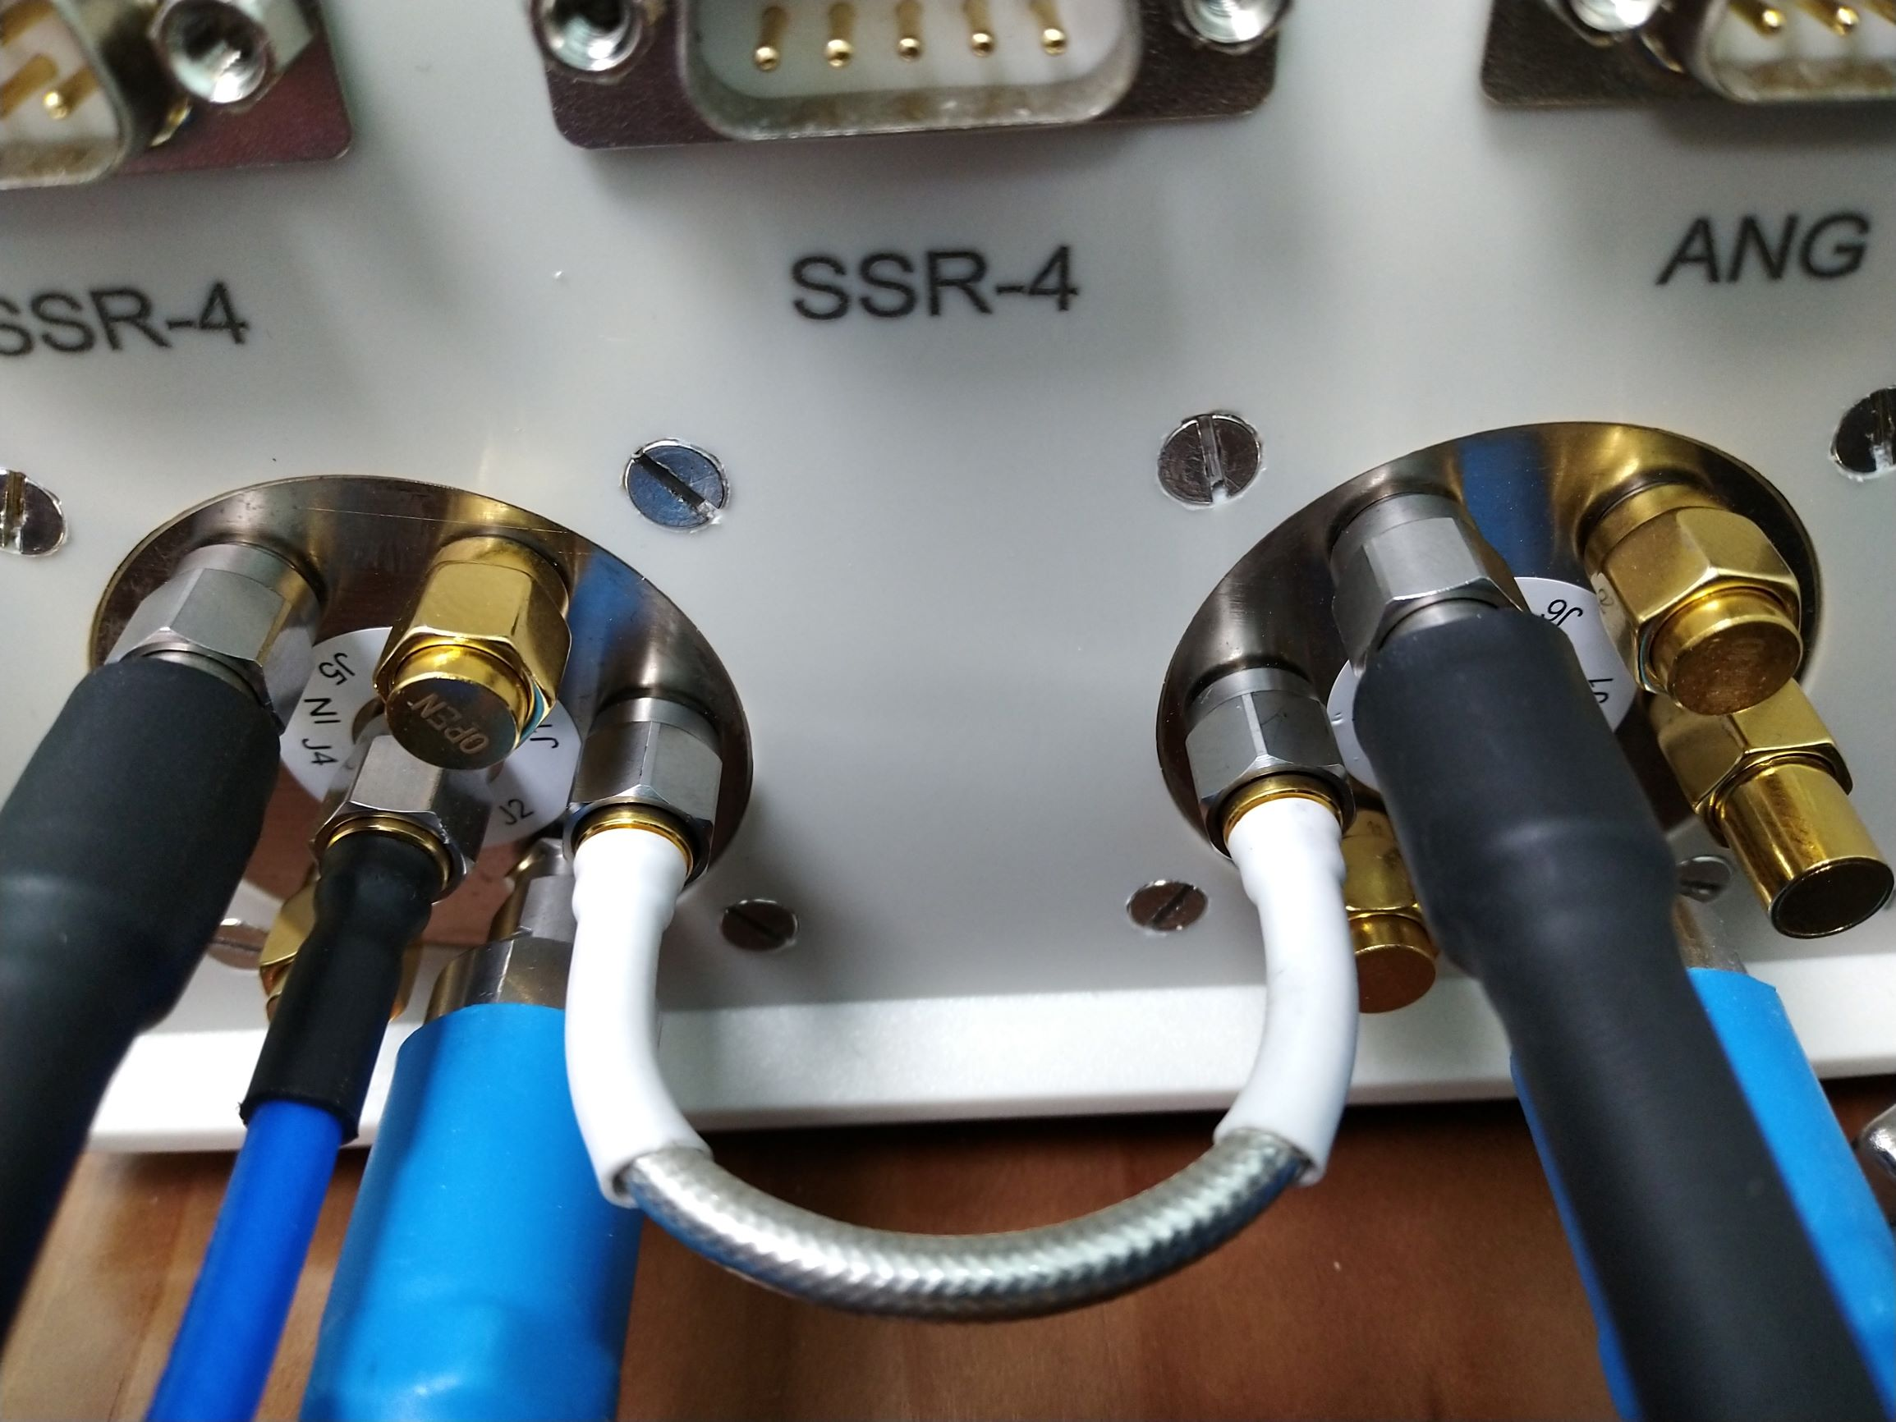
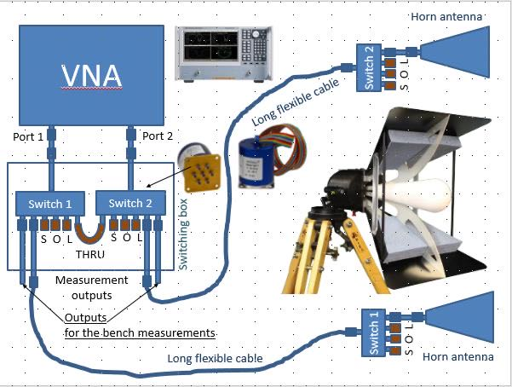
Short cable before the switching box
Port I
SP4T RF switch inside the antenna pillars
with SOL/OSM coaxial terminations
Long antenna cable
Stage II:
Deembedding
Antenna and free space
Stage III:
Response&Isolation
TRL
VNA
Stage I:
SOLT/TOSM
Sample
SP6T RF switches at the switching box with SOLT/TOSM coaxial terminations
Stage III:
Response&Isolation
TRL
Stage II:
Deembedding
Short cable before the switching box
Port II
Long antenna cable

Slide 3
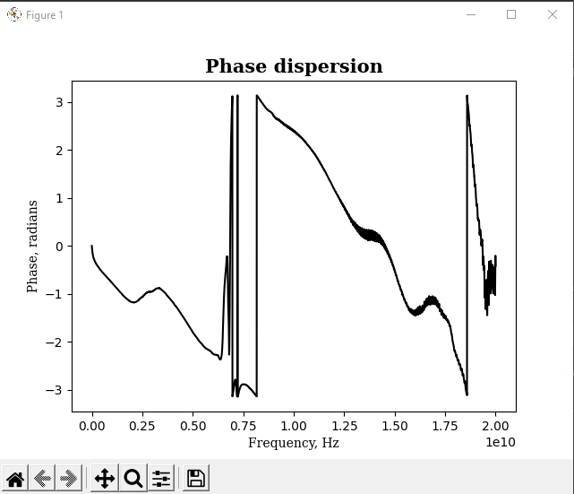
Choose parallel lines in the phase dispersion
The frequency range may include the phase jumps but they must be “clear”, not as in this graph on the right
That is why we will choose only the second line after the multiple jumps on the left and before the jumps on the right
Even for this part (without jumps), we will select a narrower frequency range
Such multiple jumps must be excluded from consideration
Frequency range that will be used for calculation of the delay time
Such single “shift” is also undesirable

Slide 4
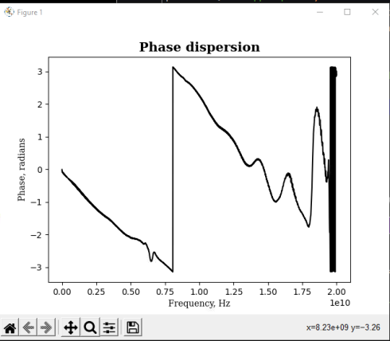
Although the two phase dispersion lines before and after the jump do not look perfectly parallel, we could try to combine them into an unwrapped phase.
Clear jump
Frequency range that will be used for calculation of the delay time

Slide 5
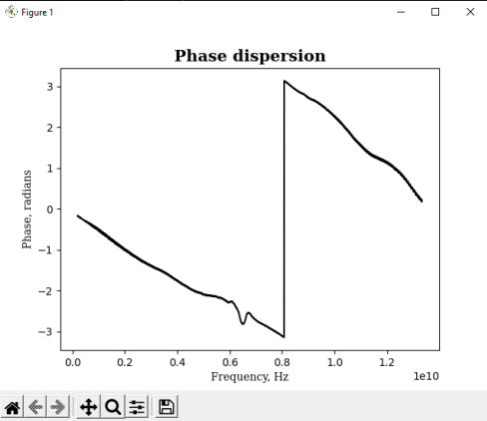
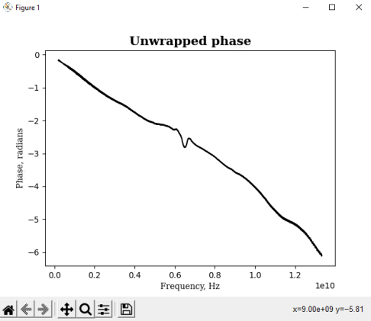
Unwrapping

Slide 6
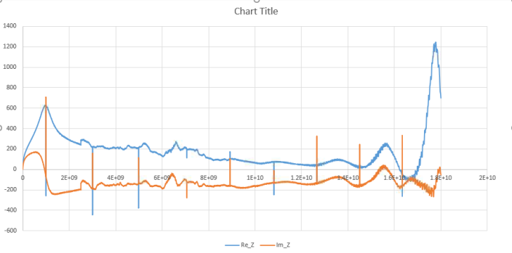
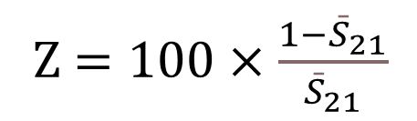
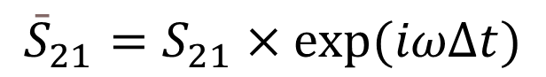
Z $=100×\frac{1−{\bar{S}}_{21}}{{\bar{S}}_{21}}$
$${\bar{S}}_{21}=S_{21}×\exp{(iωΔt)}$$
Z⎢, Ω
Spikes due to numerical uncertainties caused by the 2-port deembedding
Frequency, Hz
The delay time has been tuned for this frequency range
Impedance dispersion measured in a ferromagnetic wire

